Slide 1
Lecture 2
Relational Model

Slide 2
Outline
Structure of Relational Databases
Fundamental Relational-Algebra-Operations
Additional Relational-Algebra-Operations
Extended Relational-Algebra-Operations

Slide 3

Relational Database
Relation-元组的集合
instructor

Slide 4

Relational Database
Formally, given sets D₁, D₂, …. D_{n} a relation r is a subset of
D₁ x D₂ x … x D_{n}
Thus, a relation is a set of n-tuples (a₁, a₂, …, a_{n}) where each a_{i} ∈ D_{i}
{22222,Einstein, Physicis, 95000}
{12121, Wu, Finance, 90000}
……
D₁={22222, 12121, ……}
D₃ ={Physics, Finance, History, Comp. Sci., ……}
D₄ ={95000, 90000, 85000, 80000, 75000, ……}

Slide 5
Relational Database
Attributes
  Each attribute of a relation has a name
  Domain of the attribute
    the set of allowed values for the attribute
  Atomicity
    Attributes are normally required to be atomic, i.e. indivisible
    （出现下面两种属性的题材不建议用于关系数据库，但是原则上允许。）
    multivalued attribute 多值属性
    composite attribute 复合属性
  Null
    The special value null is a member of every domain

Slide 6
Relational Database
Tuple
  An element of relation r
  A row in a table
属性 attributes
(列 columns)
元组 tuples
(行 rows)

Slide 7
Relational Database
Table
  Current value of a relation (relation instance)
Relation Schema: The structure of a relation
  instructor is a relation
  instructor (id, name, dept_name, salary)
  Corresponding relation schema
  R = (id, name, dept_name, salary)
  instructor is a relation on relation schema R
  instructor(R)
一般的，关系模式R可以表示为
R = (A₁, A₂, …, A_{n})，其中A₁, A₂, …, A_{n}是属性
具有关系模式R的关系可以表示为 r(R)

Slide 8
Relational Database
Order of tuples is irrelevant
  We do not know the order of the tuples.
  We have to specify the order if we want to visit the tuples orderly.
  We can order the tuples by any attribute(s) that we specify.

Slide 9
Relational Database
Database
  A database consists of multiple relations
  Each relation stores one part of information
    Information about an enterprise is broken up into parts
student : stores information about students
advisor : stores information about which instructors
advise which students
instructor : stores information about instructors
    Why not store all information as a single relation?
    从业务上来说，三件事情的关注点是不同的、分离的。从计算机视角，是为了减少冗余。
    How to break up these information reasonably?
    见下一页

Slide 10
Relational Database
Key (键、码)
  Superkey (超键)
    Set of attributes属性集
    Values for which are sufficient to identify a unique tuple of each possible relation r(R)其值能够唯一确定元组。
  Candidate key (候选键)
    Is a superkey, and it is 极小的一个超键，任意真子集非超键
    Minimal (any part of which is not a superkey)
  Primary key (主键)
    A selected candidate key被选用的候选键，其选取与简单性，与bissness业务决策有关。
  Foreign key (外键)
    Set of attributes, which are primary keys in some other relation(s)一个关系中的某属性是另一个关系的主键。
    referencial integrity参照完整性/引用完整性约束：一个关系的某属性是另一个关系的主键
    entity integrity实体完整性约束：主键不能为空值

Slide 11

Schema Diagram模式图
在视图层，选课的用户可以只看到cource_id和sec_id.如SOFT130015.01
不同的course_id下可以有相同sec_id
同一门课可能有两个时间段。比如周三一次课，周五一次课。。所以time_slot_id此时可能一样

Slide 12
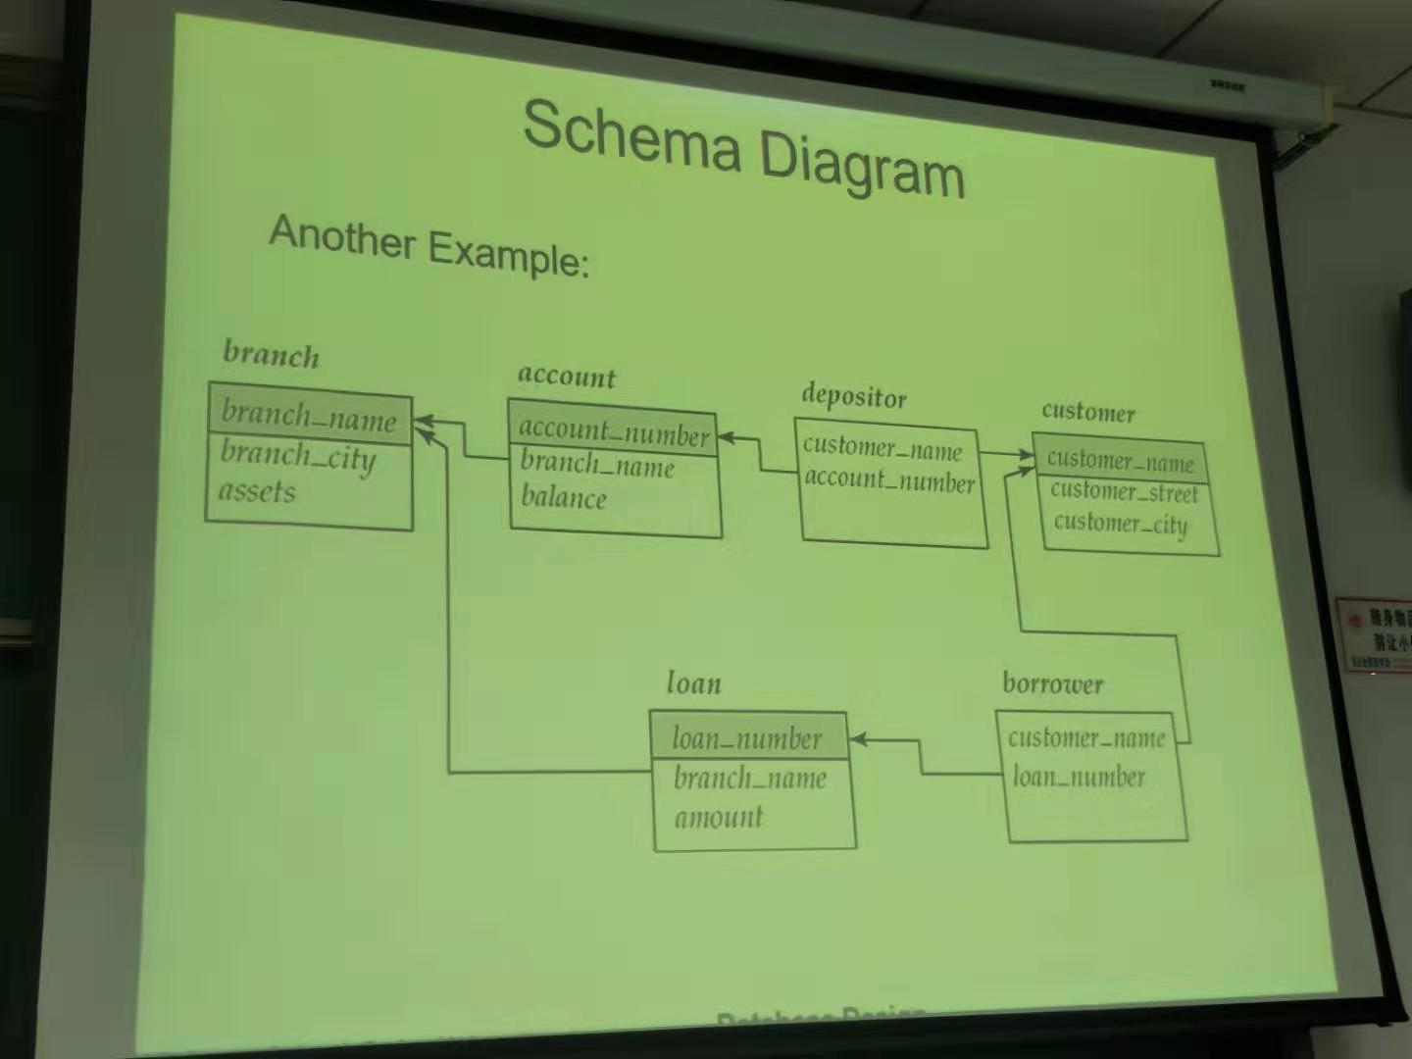
在这个模式图中，一个存户可以有多个账户，一个账户也可以多人持有。
灰色表示主键
存户

Slide 13
Relational Database
Basic concepts. * SUMMARY *
  关系模式——属性序列
  关系——建立在关系模式上
    其值可以表示为集合形式，也可以表示为“表”
    其中的元素是元组。
  关系实例——关系的当前值
  表——表示关系的当前值，即表示关系实例
  属性——在关系模式上讨论，也可以在表上讨论
    在表上讨论时，可称作“列”
  元组——关系的（某个）元素，表示值；关系模式上并没有元组，但元组必定基于某个关系模式
    在表上讨论时，可称作“行”
  (关系)数据库——一组关系
  键

Slide 14
Relational Algebra
How to make use of a database?
  Language in which user requests information from the database
  Query language does more than “querying” data.
获取数据库中信息和一些其他操作。
“Pure” languages:纯语言
  Relational algebra
  Tuple relational calculus元组关系演算
  Domain relational calculus域关系演算
These three pure languages are equivalent in computing power这三种纯语言等价的
  form up a basis of query languages that people use

Slide 15
Relational Algebra
Procedural language
Six basic operators
  选择 select: σ xigema
  投影 project: ∏ pai
  并 union: ∪
  差集 set difference: –
  笛卡尔积 Cartesian product: x
  重命名 rename: ρ rou
Inputs: one or two relations (incl. constant relation)
Outputs: a new relation

Slide 16
选择 (select)
Relation r
A
B
C
D
α
α
β
β
α
β
β
β
1
5
12
23
7
7
3
10
σ_{A=B∧D>5} (r)
A
B
C
D
α
β
α
β
1
23
7
10

Slide 17
选择 (select)
Notation: σ _{p}(r)，r表示一个关系
p is called the selection predicate（选择谓词）
Defined as:
σ_{p}(r) = {t | t ∈ r and p(t)}
Where p is a formula in propositional calculus consisting of terms connected by : ∧ (and), ∨ (or), ¬ (not)
Each term is one of:
<attribute> op <attribute>
<attribute> op <constant>
where op is one of: =, ≠, >, ≥. <. ≤
Example of selection:
σ _{dept_name=“Physics”}(instructor)

Slide 18
投影 (project)
Relation r:
∏_{A,C} (r)
A
B
C
α
α
β
β
10
20
30
40
1
1
1
2
A
C
A
C
α
α
β
β
1
1
1
2
α
β
β
1
1
2
=

Slide 19

投影 (project)
Notation:
where A₁, A₂ are attribute names and r is a relation name.
The result is defined as the relation of k columns obtained by erasing the columns that are not listed
Duplicate rows removed from result, since relations are sets
Example: To eliminate the salary and id attributes of instructor
∏_{name, dept_name} (instructor)
取某些属性组成的子关系，并去除重复的元组。

Slide 20
并 (union)
A
B
A
B
Relations r, s:
α
α
β
1
2
1
α
β
2
3
s
r
r ∪ s:
A
B
α
α
β
β
1
2
1
3

Slide 21
并 (union)
Notation: r ∪ s
Defined as:
r ∪ s = {t | t ∈ r or t ∈ s}
For r ∪ s to be valid :
1. r, s must have the same arity (same number of attributes)相同数量的参数
2. The attribute domains must be compatible属性域是相互兼容。

Slide 22
差集 (set difference)
A
B
A
B
Relations r, s:
α
α
β
1
2
1
α
β
2
3
s
r
r – s:
A
B
α
β
1
1

Slide 23
差集 (set difference)
Notation r – s
Defined as:
r – s = {t | t ∈ r and t ∉ s}
Set differences must be taken between compatible relations.
  r and s must have the same arity
  attribute domains of r and s must be compatible

Slide 24
笛卡尔积 (Cartesian product)
A
B
C
D
E
Relations r, s:
α
β
1
2
α
β
β
γ
10
10
20
10
a
a
b
b
r
s
A
B
C
D
E
r x s:
α
α
α
α
β
β
β
β
1
1
1
1
2
2
2
2
α
β
β
γ
α
β
β
γ
10
10
20
10
10
10
20
10
a
a
b
b
a
a
b
b

Slide 25
笛卡尔积 (Cartesian product)
Notation r x s
Defined as:
r x s = {t q | t ∈ r and q ∈ s}
Assume that attributes of r(R) and s(S) are disjoint. (That is, R ∩ S = ∅).
If attributes of r(R) and s(S) are not disjoint, then renaming must be used.对相同名字的属性继续rename

Slide 26
笛卡尔积 (Cartesian product)
A
B
A
D
E
Relations r, s:
α
β
1
2
α
β
β
γ
10
10
20
10
a
a
b
b
r
s
r.A
B
s.A
D
E
r x s:
α
α
α
α
β
β
β
β
1
1
1
1
2
2
2
2
α
β
β
γ
α
β
β
γ
10
10
20
10
10
10
20
10
a
a
b
b
a
a
b
b

Slide 27
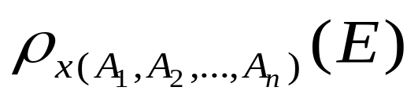
Renaming
Allows us to refer to a relation by more than one name
  可以通过不同的名字引用同一个关系
Example:
ρ _{x} (E)
returns the expression E under the name X
If a relational-algebra expression E has arity n, then
returns the result of expression E under the name X, and with the
attributes renamed to A₁ , A₂ , …., A_{n} .

Slide 28
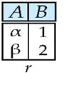
Renaming
Relation r
r x ρ _{s} (r)
r.A r.B s.A s.B
α
α
β
β
1
1
2
2
α
β
α
β
1
2
1
2

Slide 29
Composite Operation
使用多个运算构造表达式
Example: σ_{A=C}(r x s)
r x s
σ_{A=C}(r x s)
A
B
C
D
E
α
α
α
α
β
β
β
β
1
1
1
1
2
2
2
2
α
β
β
γ
α
β
β
γ
10
10
20
10
10
10
20
10
a
a
b
b
a
a
b
b
A
B
C
D
E
α
β
β
1
2
2
α
β
β
10
10
20
a
a
b

Slide 30
Example Queries
Select and Project
  Find instructors with salary greater than $85,000
  Find the ID and salary of the instructors with salary greater than $85,000
σ_{salary > 85000} (instructor)
∏_{id, salary} (σ_{salary} _{> 85000} (instructor))

Slide 31
Example Queries
Union and Set-Difference
  拥有贷款或者存款的客户名
  拥有存款但没有贷款的客户名
  拥有存款和贷款的客户名
∏_{customer_name} (borrower) ∪ ∏_{customer_name} (depositor)
∏_{customer_name} (depositor) - ∏_{customer_name} (borrower)
∏_{customer_name} (depositor) - (∏_{customer_name} (depositor) - ∏_{customer_name} (borrower))

Slide 32
Example Queries
Cartesian-Product
  在Perryridge分行有贷款的客户名
  在Perryridge分行有贷款但在任何分行都没有存款的客户名
∏_{customer_name} (σ_{branch_name=“Perryridge”}
(σborrower.loan_number = loan.loan_number(borrower x loan)))
∏_{customer_name} (σ_{branch_name = “Perryridge”}
(σborrower.loan_number = loan.loan_number(borrower x loan))) – ∏_{customer_name}(depositor)
外键

Slide 33
Example Queries
关系运算的组合顺序
  在Perryridge分行有贷款的客户名
    先算borrower x loan
    先对loan进行branch_name=“Perryridge”选择
  ∏_{customer_name} (σ_{branch_name = “Perryridge”} (
  σborrower.loan_number = loan.loan_number (borrower x loan)))
  ∏_{customer_name}(σloan.loan_number = borrower.loan_number (
  (σ_{branch_name = “Perryridge”} (loan)) x borrower))

Slide 34
Example Queries
在所有存款帐户中找最高余额
  要找一个余额
    要在关系account中找balance (project on balance)
  要找一个比其他余额都高的余额
    要在关系account的内部比较两个balance (rename account as d)
    余额比其他余额高 (select with account.balance > d.balance ?!)
      只要能找到一个更低的余额，就满足条件（找到了除了最低余额外的其他所有余额）
  找出除最高余额外的其他所有余额（所有非最高余额） account.balance < d.balance
  找出全部余额和非最高余额的差集（就是最高余额）

Slide 35
Example Queries
在所有帐户中找最高余额
  找出所有非最高余额
    对一个余额，有其他余额大于它
  找出全部余额和非最高余额的差集
∏_{balance} ( )
account
-
∏_{account.balance}
( )
∏_{balance} ( )
account x ρ_{d} (account)
σ_{account.balance < d.balance} ( )

Slide 36
Basic Operators - Summary
Let E₁ and E₂ be relational-algebra expressions; the following are all relational-algebra expressions:
  E₁ ∪ E₂
  E₁ – E₂
  E₁ x E₂
  σ_{p} (E₁), P is a predicate on attributes in E₁
  ∏_{s}(E₁), S is a list consisting of some of the attributes in E₁
  ρ _{x} (E₁), x is the new name for the result of E₁

Slide 37
Additional Operations
集合交 (Set-intersection)
自然联结 (Natural-join)
除 (Division)
赋值 (Assignment)

Slide 38
集合交 (set-intersection)
Relation r, s:
r ∩ s
A B
A B
α
α
β
1
2
1
α
β
2
3
r
s
A B
α 2

Slide 39
集合交 (set-intersection)
Notation: r ∩ s
Defined as:
r ∩ s = { t | t ∈ r and t ∈ s }
Assume:
  r, s have the same arity
  attributes of r and s are compatible
Note: r ∩ s = r – (r – s)

Slide 40
自然联结（natural-join）
Relations r, s:
A
B
C
D
B
D
E
α
β
γ
α
δ
1
2
4
1
2
α
γ
β
γ
β
a
a
b
a
b
1
3
1
2
3
a
a
a
b
b
α
β
γ
δ
∈
r
s
r s
A
B
C
D
E
α
α
α
α
δ
1
1
1
1
2
α
α
γ
γ
β
a
a
a
a
b
α
γ
α
γ
δ

Slide 41
自然联结（natural-join）
Let r and s be relations on schemas R and S respectively.
Then, natural-join r s is a relation on schema R ∪ S obtained as follows:
  Consider each pair of tuples t_{r} from r and t_{s} from s.
  If t_{r} and t_{s} have the same value on each of the attributes in R ∩ S, add a tuple t to the result, where
    t has the same value as t_{r} on r
    t has the same value as t_{s} on s
Example:
  R = (A, B, C, D)
  S = (E, B, D)
  Result schema = (A, B, C, D, E)
  r s is defined as:
  ∏_{r.A, r.B, r.C, r.D, s.E} (σ_{r.B = s.B} ∧ _{r.D = s.D} (r x s))

Slide 42
除 (division)
Relations r, s:
A
B
B
α
α
α
β
γ
δ
δ
δ
ε
ε
β
1
2
3
1
1
1
3
4
6
1
2
1
2
s
r
r ÷ s:
A
α
β

Slide 43
除 (division)
Let r and s be relations on schemas R and S respectively where
  R = (A₁, …, A_{m} , B₁, …, B_{n} )
  S = (B₁, …, B_{n})
  The result of r ÷ s is a relation on schema
  R – S = (A₁, …, A_{m})
  r ÷ s = { t | t ∈ ∏ _{R-S} (r) ∧ ∀ u ∈ s ( tu ∈ r ) }
  Where tu means the concatenation of tuples t and u to produce a single tuple

Slide 44
除 (division)
Relations r, s:
A
B
C
D
E
D
E
α
α
α
β
β
γ
γ
γ
a
a
a
a
a
a
a
a
α
γ
γ
γ
γ
γ
γ
β
a
a
b
a
b
a
b
b
1
1
1
1
3
1
1
1
a
b
1
1
s
r
r ÷ s:
A
B
C
α
γ
a
a
γ
γ

Slide 45
除 (division)
Property
  q = r ÷ s
  Then q is the largest relation satisfying q x s ⊆ r
用关系代数基本运算表示除
Let r(R) and s(S) be relations, and let S ⊆ R
r ÷ s = ∏_{R-S} (r ) – ∏_{R-S} ( ( ∏_{R-S} (r ) x s ) – ∏_{R-S,S}(r ))
写成这样是亿万，可能S中选择的属性是插空的。如选择了C，E。这样可以保持顺序一致
r
A
B
C
D
E
s
D
E
α
α
α
β
β
γ
γ
γ
a
a
a
a
a
a
a
a
α
γ
γ
γ
γ
γ
γ
β
a
a
b
a
b
a
b
b
1
1
1
1
3
1
1
1
a
b
1
1

Slide 46
赋值 (assignment)
Notation ←
  使用临时变量保存关系运算的结果
  简化关系表达式的表示
r ÷ s may be expressed as:
temp1 ← ∏_{R-S} (r )
temp2 ← ∏_{R-S} ((temp1 x s ) – ∏_{R-S,S} (r ))
r ÷ s = temp1 – temp2
  The result to the right of the ← is assigned to the relation variable on the left of the ←
  May use variable in subsequent expressions

Slide 47
Example Queries
Set-Intersection
  Find the ids of the courses taught in Fall 2009 as well as in Spring 2010
∏_{course_id} (σsemester = ‘Fall’ ∧ year = 2009 (section))
∩
∏_{course_id} ( σsemester = ‘Spring’ ∧ year = 2010 (section))

Slide 48
Example Queries
Natural-join
  Find the names of instructors and the corresponding ids of the courses taught by the instructors
  Find the names of instructors and the corresponding ids of the courses taught by the instructors, and show the year in which the courses were taught
∏_{name, course_id} (instructor teaches)
∏_{name, course_id, year} (instructor teaches)

Slide 49
Example Queries
Division
  Find the names of instructors and the corresponding ids of the courses taught by the instructors in both 2010 and 2011
  ∏_{name, course_id, year} (instrcutor teaches)
  ÷ ρ_{temp(year)} ({(2010), (2011)})
    一般的查询方法
    ∏_{name, course_id} (σ_{year = 2010} (instrcutor teaches))
    ∩ ∏_{name, course_id} (σ_{year = 2011} (instrcutor teaches))
  What does the following query mean?
  ∏_{name, course_id, year} (instrcutor teaches)
÷ ∏_{year} (σ_{semester = “Fall”} (section))

Slide 50
Review
基本的关系代数运算
  六种基本运算符，其中：
  一元运算符和二元运算符各三种
附加的关系代数运算
  能够由基本关系代数运算表达
  丰富和简化了关系代数的表达方式

Slide 51
Extended Operations
泛化投影 (Generalized Projection)
聚合函数 (Aggregate Functions)
外联结 (Outer Join)

Slide 52
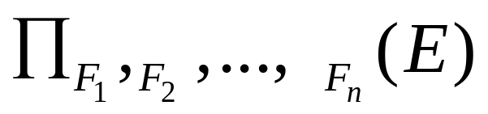
Generalized Projection
E is any relational-algebra expression
Each of F₁, F₂, …, F_{n} are are arithmetic expressions involving constants and attributes in the schema of E
Extended project operation
  allowing arithmetic functions to be used in the projection list
Example
  Relation credit_info(customer_name, limit, credit_balance)
  Find how much more each person can spend :
∏customer_name, limit – credit_balance (credit_info)

Slide 53
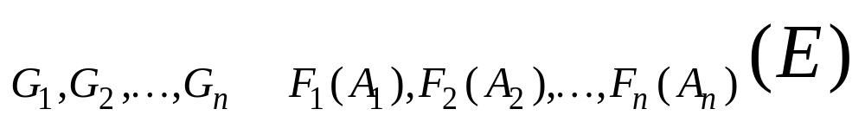

聚合 (Aggregation)
Aggregation function (聚合函数)： takes a collection of values and returns a single value as a result
avg: average value
min: minimum value
max: maximum value
sum: sum of values
count: number of values
Aggregate operation in relational algebra
E is any relational-algebra expression
  G₁, G₂ …, G_{n} is a list of attributes on which to group (can be empty)
  Each F_{i} is an aggregate function
  Each A_{i} is an attribute name

Slide 54
Aggregation Examples
Relation r:
A
B
C
α
α
β
β
α
β
β
β
7
7
3
10
g _{sum(c)} (r)
sum(c )
27

Slide 55

Aggregation Examples
Relation instructor grouped by dept_name:
name
dept_name
salary
Einstein
Gold
Wu
Singh
Mozart
Physics
Physics
Finance
Finance
Music
95000
87000
90000
80000
40000
_{dept_name} g _{sum(salary)} (instructor)
dept_name
Physics
Finance
Music
182000
170000
40000

Slide 56
聚合 (Aggregation)
Renaming the result of aggregation
  Result of aggregation does not have a name
  For convenience, we permit renaming as part of aggregate operation
_{dept_name} g _{sum(salary) as sum_salary} (instructor)
dept_name
sum_salary
Physics
Finance
Music
182000
170000
40000

Slide 57


Outer Join
Relation course
Relation prereq
Inner Join (Natural Join)
course prereq
course_id
title
dept_name
credits
prereq_id
BIO-301
CS-190
Genetics
Game Design
Biology
Comp.Sci.
4
4
BIO-101
CS-101

Slide 58

Outer Join
Relation course
Relation prereq
Left Outer Join
course prereq

Slide 59

Outer Join
Relation course
Relation prereq
Right Outer Join
course prereq

Slide 60

Outer Join
Relation course
Relation prereq
Full Outer Join
course prereq

Slide 61
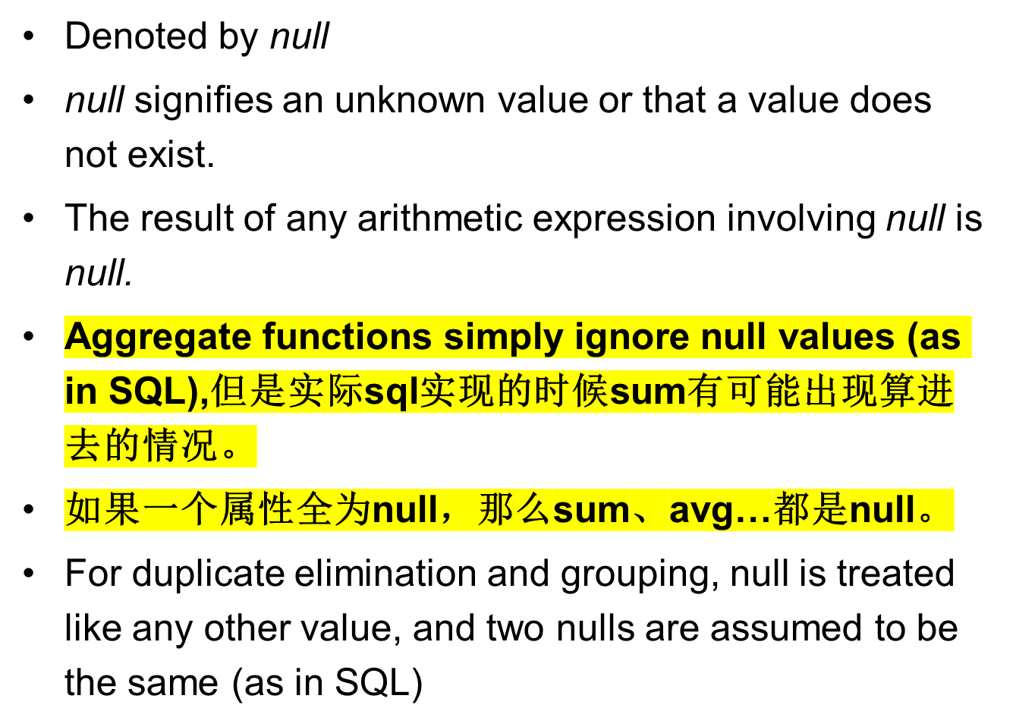
Null Values (空值)

Slide 62
Null Values (空值)
Three-valued logic using the truth value unknown:
  OR: (unknown or true) = true,
  (unknown or false) = unknown
  (unknown or unknown) = unknown
  AND: (true and unknown) = unknown,
  (false and unknown) = false,
  (unknown and unknown) = unknown
  NOT: (not unknown) = unknown
Result of select predicate is treated as false if it evaluates to unknown

Slide 63
Modification of the Database
The content of the database may be modified using the following operations
  添加(insertion)
  删除(deletion)
  修改(updating)
Expressed using the assignment operator

Slide 64
添加 (insertion)
r ← r ∪ E
where r is a relation and E is a relational algebra expression
To insert data into a relation, we either:
  specify a tuple to be inserted (E is a constant relation, containing only one tuple)
  write a query whose result is a set of tuples to be inserted
例
account ← account ∪ {(“Perryridge”, A-973, 1200)}

Slide 65
删除 (deletion)
r ← r – E
where r is a relation and E is a relational algebra query
Selected tuples are removed from the database.
  similarly to a query
  can delete only whole tuples
  cannot delete values on only particular attributes
例
account ← account – σ _{branch_name = “Perryridge”} (account)
loan ← loan – σ _{amount ≥ 0 and amount ≤ 50} (loan)

Slide 66
删除 (deletion)
例
  删除位于Needham市的分行的所有存款帐户
r₁ ← σ _{branch_city = “Needham”} (account branch )
r₂ ← ∏branch_name, account_number, balance (r₁)
r₃ ← ∏ _{customer_name, account_number} (r₂ depositor)
account ← account – r₂
depositor ← depositor – r₃

Slide 67
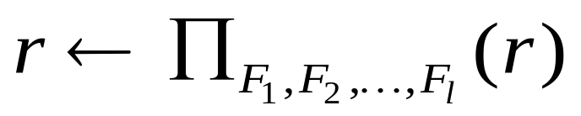
更新 (Updating)
其中r是关系，
F_{i}是
  r 的第 i 个属性（如果第 i 个属性不需要修改）； 或
  仅包含常量和r中属性的算术表达式，根据此值更新 r 的第 i 个属性
Each F_{i} is either
  the i ^{th} attribute of r, if the i ^{th} attribute is not updated, or,
  if the attribute is to be updated, an expression, involving only constants and the attributes of r, which gives the new value for the attribute
Change a value in a tuple without changing all values in the tuple

Slide 68
更新 (Updating)
例
  向存款帐户发放利息，金额为存款帐户余额的5%
  对余额超过10000元的存款帐户支付6%的红利，其他存款帐户支付5%的红利
account ← ∏ account_number, branch_name, balance * 1.05 (account)
account ←
∏ account_number, branch_name, balance*1.06 (σ _{balance > 10000} (account ))
∪ ∏ account_number, branch_name, balance*1.05 (σ_{balance ≤ 10000} (account))

Slide 69
小结
什么是关系数据库？
关系代数的六个基本操作以及其他的关系运算
采用关系代数表达式表示数据库查询和修改操作
  简单查询
  组合查询
  增、删、改
外联结在数据库查询中的作用

Slide 70
Next Lecture
SQL
  从纯语言到应用
  在实践中学习各类查询语言的用法

Slide 71
End of
Lecture 2
Relational Model

